Slide 1
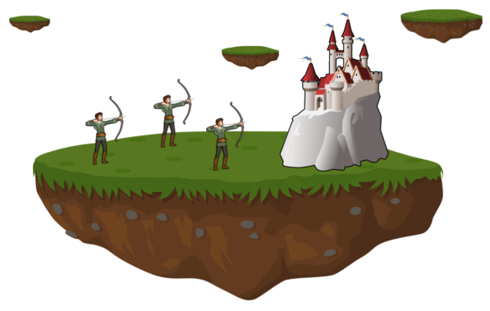
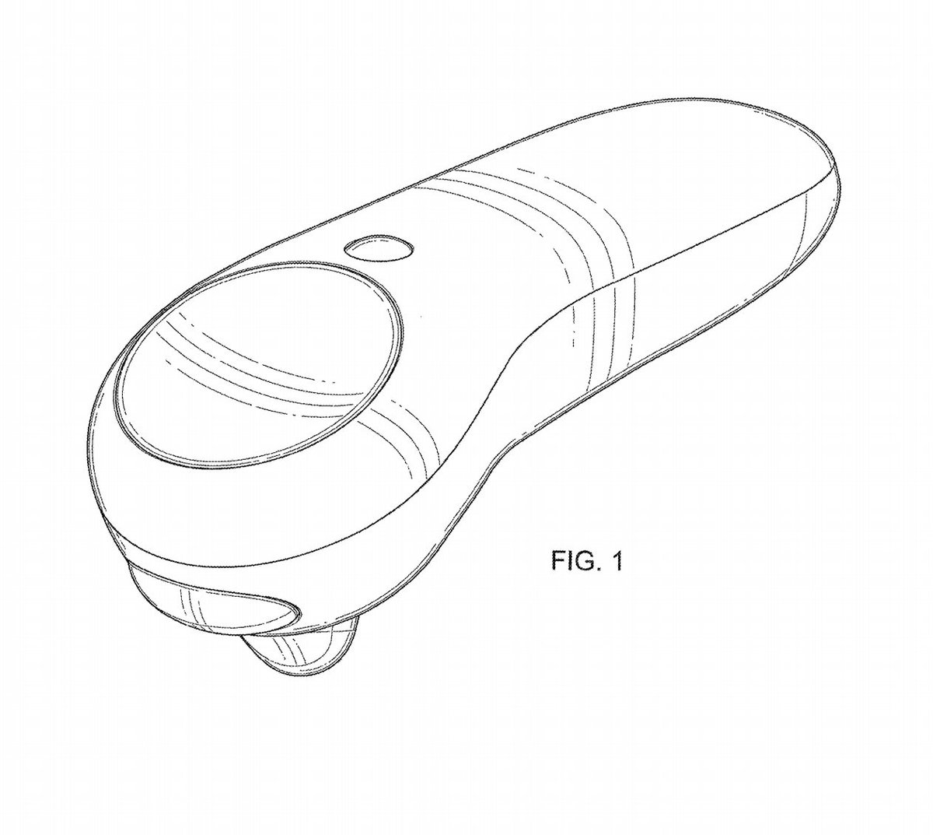
4-Fun
Battle for islands floating around you!
Anny Kong, Charles Mihran,
Xiuxing Lao, Yuyang Ge
Controls
Spawn Archer
(Quick Tap) Zoom In
(Hold for 1s) Zoom Out
Collect Crate

